Slide 1
WEEKLY UPDATE
Tuesday, November 17, 2021
Buket Torun

Slide 2
What’s new?
location_of_train → positions_of_train
Setting " flag " parameter to choose the version of the simulator
Importing functions from another python file;
import file_name
file_name.functions_name
The new "parameters " python file created

Slide 3


What’s new?
t_{n}
{d_{n,k}}
{Pr_{n,k}}
{BLER_{n,k}}
Measurement
results
SNR-BLER
Pr-BLER
BLER
1
0
-98
Pr (dBm)
Device: Pycom FiPy 1.0 Receiver Sensitivity=-98 dBm

Slide 4
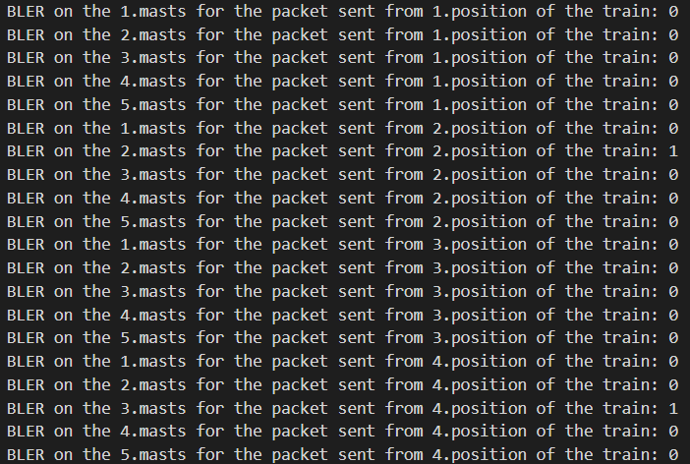
Device: Pycom FiPy 1.0 Receiver Sensitivity=-98 dBm

Slide 5
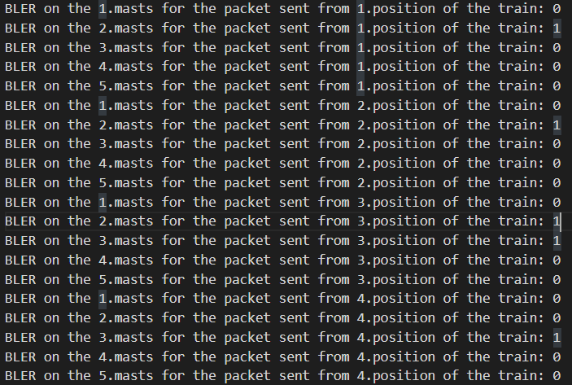
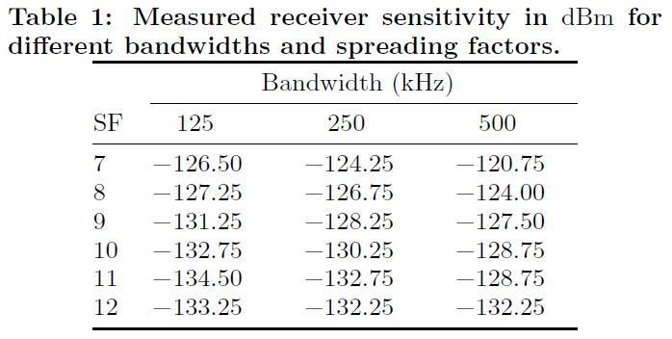

d₀ =40m
L_{pl}(d₀) = -127.41 dB
γ = 2.08
σ = 3.57
Buit up env
Device: Pycom FiPy 1.0 Receiver Sensitivity=-98 dBm
[Do LoRa Low-Power Wide-Area Networks Scale?, 2016]

Slide 6
What’s new?
250 m
Last Station
First Station
MB1
MA2
MA3
MA4
…
MB120
S12
S23
S34
S45
S119120
…
After t s
Simulator V2
V4
V3
V2
V1
V4
V3
V2
V1
100 m
25 m
25 m
25 m
(x₄,y₄,z₄)
(x₃,y₃,z₃)
(x₂,y₂,z₂)
V=Speed of the train
(x₁,y₁,z₁)

